Slide 1

Aditya University
FRESHMAN ENGINEERING DEPARTMENT-II
DATA SCIENCE-8
STUDENT ACTIVITY-ROLE PLAY
SELECTION SORT TECHNIQUE.
Programming
for
Problem Solving Using C
Dr.N.RAHUL PAL
Assistant Professor,
Freshmen Engineering Department

Slide 2

Aditya University
FRESHMAN ENGINEERING DEPARTMENT

Slide 3
Syllabus
UNIT – IV
Functions: Introduction to Functions, Function Declaration and Definition, Function call Return Types and Arguments, arrays as parameters, Scope and Lifetime of Variables, storage class, recursion, functions and arrays.

Slide 4
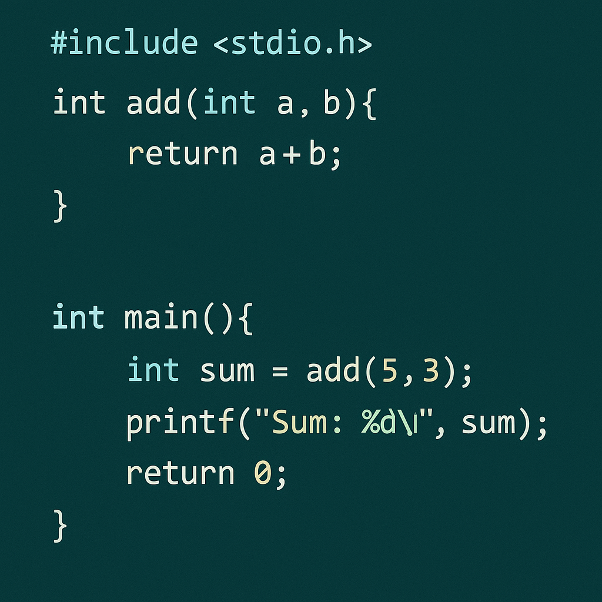
Function
In c, we can divide a large program into the basic building blocks known as function.
Function is a block of statements which can be used to perform a particular task.
A function is a group of statements that together perform a
task.
Every C program has at least one function, which is main().
We can divide up your code into separate functions.

Slide 5
Advantage of functions in C
By using functions, we can avoid rewriting same logic/code again and again in a program.
We can call C functions any number of times in a program and from any place in a program.
We can track a large C program easily when it is divided into multiple functions.
Reusability is the main achievement of C functions

Slide 6
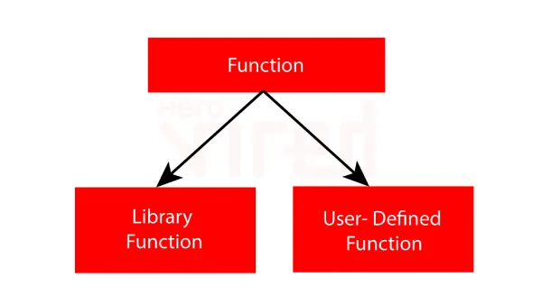
Functions
There are two types of functions in C programming:
1.Library Functions (or built in or predefined): are the functions which are declared in the C header files such as scanf(), printf(), gets(), puts(), ceil(), floor() etc.
2.User-defined functions: are the functions which are created by the C
programmer, so that he/she can use it many times. It reduces the
complexity of a big program and optimizes the code

Slide 7
Functions
There are three aspects of a C function
1.Function declaration A function must be declared globally in a c program to tell the compiler about the function name, function parameters, and return type.
2.Function definition It contains the actual statements which are to be executed. It is the most important aspect to which the control comes when the function is called. Here, we must notice that only one value can be returned from the function.
3.Function call Function can be called from anywhere in the program. The parameter list must not differ in function calling and function declaration. We must pass the same number of functions as it is declared in the function declaration.

Slide 8
Function Declaration
syntax:
returntype function_name( parameter list );
Return_type can be of any data type such as int, double, char ,void ,short etc.
Parameters and Arguments :
Information can be passes to functions as a parameter. These are act as variables inside the function.
Parameters are specified after the function name, inside the parentheses. You can add as many parameters as you want, separate them with a comma.

Slide 9
Return Data_Type: It defines the return data type of a value in the function. The return data type can be integer, float, character, etc.
Function Name: It defines the actual name of a function that contains some parameters.
Parameters/ Arguments: It is a parameter that passed inside the function name of a program. Parameters can be any type, order, and the number of parameters.
Function Body: It is the collection of the statements to be executed for performing the specific tasks in a function.

Slide 10
Function Definition
syntax:
returntype function_name( parameter list )
{
body of the function
}
parameter list is in the following form:
datatype var1,datatype var2,datatype var3……
returntype function_name(datatype var1,datatype var2,datatype var3…………)
{
body of the function
}

Slide 11
Function call
Function can be called from anywhere in the program.
The parameter list must not differ in function calling and function declaration.
A function call is an important part of the C programming language. It is called inside a program whenever it is required to call a function.
It is only called by its name in the main() function of a program.
We can pass the parameters to a function calling in the main() function as it is declared in the function declaration.
syntax: function_name(parameters);

Slide 12
Functions
Defining a Function:
return_type function_name( parameter list )
{
body of the function
}
Calling a Function:
functionname(parameters)

Slide 13
Functions
Defining a Function:
void addition( int a ,int b)
{int sum; sum=a+b;
}
Calling a Function:
addition(10,20);

Slide 14
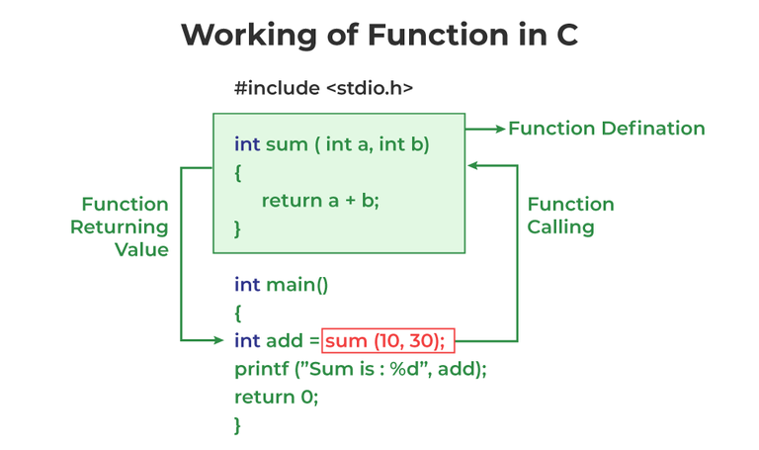

Slide 15
Program to print your name without functions
int main()
{
printf(“HelloWorld); return 0;
}
Program to print your name with functions
int main()
// Write a function to display Hello World
{
display(); return 0;
}
void display()
{
printf(“Hello World”);
}

Slide 16
Different aspects of function calling
A function may or may not accept any argument. It may or may not return any value.
Based on these facts, There are four different aspects of function calls.
function without arguments and without return value
function without arguments and with return value
function with arguments and without return value
function with arguments and with return value

Slide 17
Example-1 for Function without argument and with out return value
// Write a function to display Hello World void display()
{
printf(“Hello World”);
}
int main()
{
display(); return 0;
}

Slide 18
Example-2 for Function without argument and without return value
int main()
{
sum(); return 0;
}
// Write a function to sum of two numbers
void sum()
{
int a,b,c;
printf(“enter two numbers”); scanf(“%d%d”,&a,&b);
c=a+b;
printf(“sum is %d”,c);
}
output:
enter two numbers 10 20
sum is 30

Slide 19
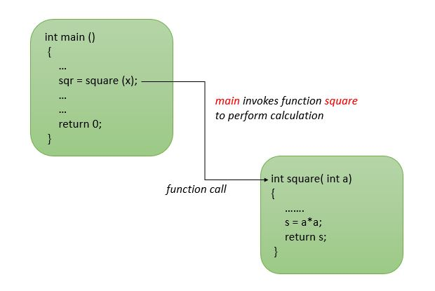
return value
A function can return value to the caller(who calls the function).
It can be done using “return” statement as follows:
return Variable/Expression;
To return a value,we need to specify return_type(type of returned value) in function definition.
Then returned value is sent to caller(where function is called).

Slide 20
Example for Function without argument and with return value
ADITYA ENGINEERING COLLEGE(A)
// Write a function to sum of two numbers _{int main()}
int sum()
{
int a,b,c;
printf(“enter two numbers”); scanf(“%d%d”,&a,&b); c=a+b;
return(c);
}
{
int result; result=sum();
printf(“ sum is %d”,result);
return 0;
}
output:
enter two numbers 10 20
sum is 30

Slide 21
Program for sum of two numbers
Function without argument and with out return value
Function without argument and with return value
#include<stdio.h>
int sum()
{
int a,b,c;
printf(“enter two numbers”); scanf(“%d%d”,&a,&b); c=a+b;
return(c);
}
int main()
{
int result;
result=sum(); // function call
printf(“ sum is %d”,result);
return 0;}
#include<stdio.h>
void sum()
{
int a,b,c;
printf(“enter two numbers”); scanf(“%d%d”,&a,&b); c=a+b;
printf(“sum is %d”,c);
}
int main()
{
sum(); // function call
return 0;
}

Slide 22
Program for sum of two numbers
3)Function with argument and without return value 4)Function with argument and with return value
#include<stdio.h>
void sum(int a,int b )
{
int c; c=a+b;
printf(“sum is %d”,c);
}
int main()
{
int a,b;
printf(“enter two numbers”); scanf(“%d%d”,&a,&b); sum(a,b);
return 0;
}
#include<stdio.h>
int sum(int a,int b )
{
int c; c=a+b; return(c);
}
int main()
{
int x,y;
printf(“enter two numbers”);
scanf(“%d%d”,&x,&y);
printf(“%d”,sum(x,y));
printf(“%d”,sum(10,20)); return 0;}

Slide 23
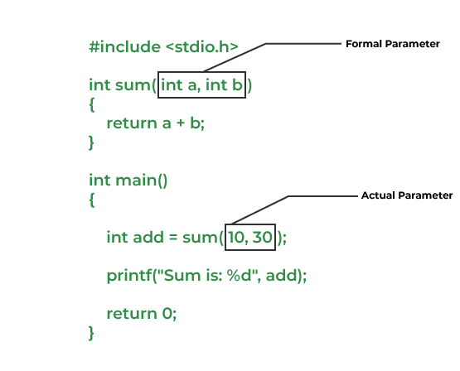
Passing Parameters to Functions
The data passed when the function is being invoked is known as the Actual parameters.
In the below program, 10 and 30 are known as actual parameters.
Formal Parameters are the variable and the data type as mentioned in the function declaration.
In the below program, a and b are known as formal parameters.

Slide 24
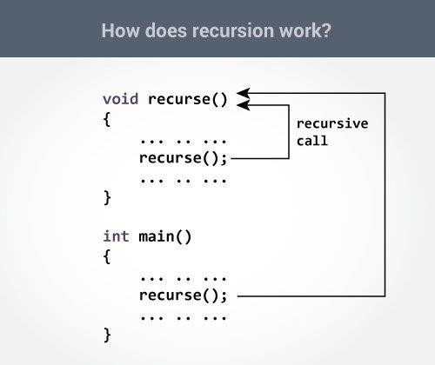
Recursive Functions
A function that calls itself is known as a recursive function. And, this technique is known as recursion.
How recursion works?
void recurse()
{
... .. ...
recurse(); // this function called in same function
... .. ...
}
int main()
{
... .. ...
recurse();
... .. ...
}

Slide 25
Basic Structure of Recursive Functions
type function_name (args) {
// function statements
// base condition
// recursion case (recursive call)
}
Fundamentals of C Recursion
The fundamental of recursion consists of two objects which are essential for any recursive function. These are:
Recursion Case
Base Condition

Slide 26
#include <stdio.h>
int nSum(int n)
{
// base condition to terminate the recursion when N = 0
if (n == 0) {
return 0;
}
// recursive case / recursive call
int res = n + nSum(n - 1);
return res;
}
int main()
{
int n = 5;
// calling the function
int sum = nSum(n);
printf("Sum of First %d Natural Numbers: %d", n, sum);
return 0;
}
Sum of First 5 Natural Numbers: 15

Slide 27
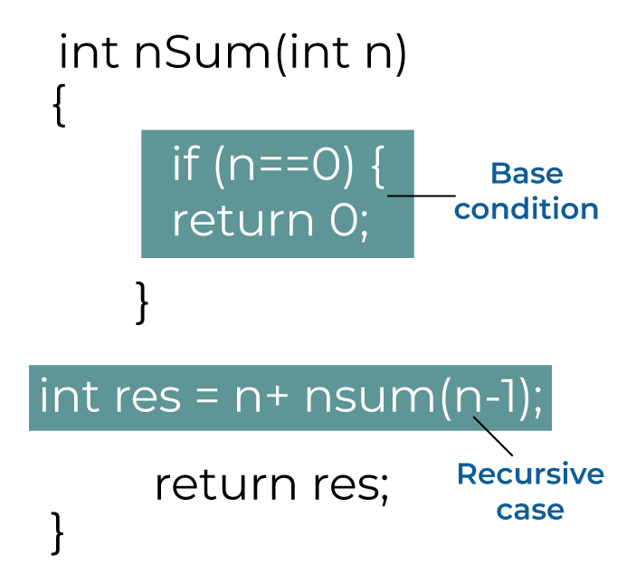
1. Recursion Case
The recursion case refers to the recursive call present in the recursive function.
It decides what type of recursion will occur and how the problem will be divided into smaller subproblems.
The recursion case defined in the nSum() function of the above example is:
int res = n + nSum(n - 1);
2. Base Condition
The base condition specifies when the recursion is going to terminate. It is the condition that determines the exit point of the recursion.
Considering the above example again, the base condition defined for the nSum() function:
if (n == 0) {
return 0;
}

Slide 28
Example-recursive function(factorial program)
#include <stdio.h> int factorial(int i)
{
if(i <= 1)
{
return 1;
}
return i * factorial(i - 1);
int main()
{
printf("%d\n",factorial(5)); return 0;
}
}

Slide 29




Example-recursive function-how it works
#include <stdio.h>
int factorial(int i)
{
if(i <= 1)
{
return 1;
}
return i * factorial(i - 1);
}
int main()
{
printf("%d\n",factorial(5)); return 0;
5*24=120
4*6=24
3*2=6
2*1=2
}

Slide 30
Example-recursive function(Fibonacci series)
#include <stdio.h>
int fibonacci(int i) {
if (i<= 1)
{
return i;
} else {
return fibonacci(i - 1) + fibonacci(i- 2);
}
}
int main()
{
int n;
printf("Enter the number of terms in the Fibonacci sequence: ");
scanf("%d", &n);
printf("Fibonacci Sequence:\n");
for (int i = 0; i < n; i++)
{
printf("%d ", fibonacci(i));
}
return 0;
}
Output:
Enter the number of terms in the Fibonacci sequence: 6
Fibonacci Sequence:
0 1 1 2 3 5

Slide 31
Array as function argument-example
In C programming, we can pass an array as a function argument.
return_type function(type arrayname[])
return_type function(type arrayname[SIZE])
int main()
{
……
function_name(arrayname);
…….
}
void function_name(datatype arrayname[])
{
……
……
…….
}

Slide 32
Array as function argument-example
#include <stdio.h>
void display(int marks[])
{
int i=0;
for (i = 0; i<6; i++)
{
printf(" %d",marks[i]);
}
}
int main() {
int marks[] = {56,89,76,98,95,56};
display(marks);
return 0;
}

Slide 33
2D Array as function argument-example
int main()
{
int arr[3][3] = {{1, 2, 3}, {4, 5, 6}, {7, 8, 9}};
int m = 3, n = 3;
print(m, n, arr);
return 0;
}
#include<stdio.h>
void print(int m, int n, int arr[m][n])
{
int i, j;
for (i = 0; i < m; i++)
{
for (j = 0; j < n; j++)
{
printf("%d ", arr[i][j]);
}
printf("\n");
}
}
Output:
1 2 3
4 5 6
7 8 9

Slide 34
Local Variable
The variables declared inside a block /function are local variables to that block /function.They are not accessible outside that block/function
#include <stdio.h> int main()
{
int i=10;
printf("%d",i); return 0;
}

Slide 35
Global Variable
Variables that are declared outside of all functions are known as external or global variables. They are accessible from any function inside the program.
#include <stdio.h>
int x=20;
int main()
{
{
printf("%d",x);
}
printf("\n%d",x);
return 0;
}

Slide 36
Scope and lifetime of a variable
Scope: The scope of a variable in C is the block or the region in the program where a variable is declared, defined, and used.
Outside this region, we cannot access the variable, and it is treated as an undeclared identifier
Lifetime: The lifetime of the variable is the time between it is allocated memory and it is deleted from the memory.

Slide 37
Storage Classes
A storage class defines the scope (visibility) and life-time of variables or functions within a C Program.
Syntax:
storage class datatype variablename;
We have four different storage classes in a C program −
auto
register
static
extern

Slide 38
automatic Storage Class
auto storage class is the default storage class for all local variables.
Automatic variables are allocated memory automatically at runtime.
The scope of the automatic variables is limited to the block in which they are defined.
The automatic variables are initialized to garbage by default.
The memory assigned to automatic variables gets freed upon exiting from the block.
The keyword used for defining automatic variables is auto.
Every local variable is automatic in C by default.
#include <stdio.h> int main()
{
int x=20;
printf("%d",x); return 0;
}
Equal to auto int x=20;

Slide 39
Static Storage Class
A static variable is declared by using the static keyword.
static variables preserve the value of their last use in their scope
#include <stdio.h> void ex()
{
static int x=10; x++;
printf(" %d",x);
}
int main()
{
ex();
ex(); return 0;
}
scope: In the same block in which it declared.
lifetime: Until the complete execution of
Program the variable will alive.
Default value: Zero

Slide 40
external storage class
Extern storage class simply tells us that the variable is defined elsewhere and not within the same block where it is used.
So an extern variable is nothing but a global variable initialized with a legal value where it is declared in order to be used elsewhere
#include <stdio.h> extern int x;
void ex()
{ printf(" %d", x);
}
scope: Throughtout the program
lifetime: Until the complete execution of
program.
int main()
{ ex(); return 0;
}
int x=10;

Slide 41
register Storage Class
The register keyword is used to declare register variables.
Register variables were supposed to be faster than local variables.
Stores the value in a register.
#include <stdio.h>
int main()
scope: In the same block in which it declared.
{
register int x=20; printf("%d",x); return 0;
}
lifetime: In the same block in which it declared.

Slide 42
Storage Classes | Storage Place | Default Value | Scope | Lifetime
auto | RAM | Garbage Value | Local | Within function
extern | RAM | Zero | Global | Till the end of the main program Maybe declared anywhere in the program
static | RAM | Zero | Local | Till the end of the main program, Retains value between multiple functions call
register | Register | Garbage Value | Local | Within the function

Slide 43
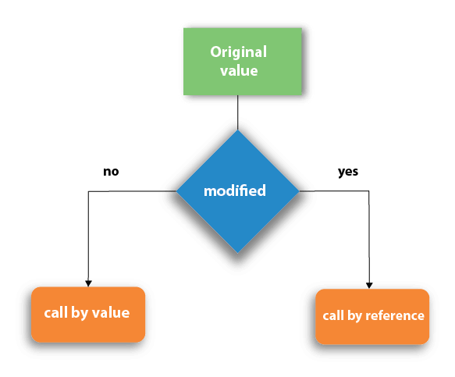
Call by value and Call by reference in C
There are two methods to pass the data into the function in C language, i.e., call by value and call by reference.

Slide 44
Call by value in C
In call by value method, the value of the actual parameters is copied into the formal parameters.
In other words, we can say that the value of the variable is used in the function call in the call by value method.
In call by value method, we can not modify the value of the actual parameter by the formal parameter.
In call by value, different memory is allocated for actual and formal parameters since the value of the actual parameter is copied into the formal parameter.
The actual parameter is the argument which is used in the function call whereas formal parameter is the argument which is used in the function definition.

Slide 45
Swapping the values of the two variables
#include <stdio.h>
void swap(int , int); //prototype of the function
int main()
{
int a = 10;
int b = 20;
printf("Before swapping the values in main a = %d, b = %d\n",a,b);
// printing the value of a and b in main
swap(a,b);
printf("After swapping values in main a = %d, b = %d\n",a,b);
// The value of actual parameters do not change by changing the formal parameters in call by value, a = 10, b = 20
}
void swap (int a, int b)
{
int temp;
temp = a;
a=b;
b=temp;
printf("After swapping values in function a = %d, b = %d\n",a,b);
// Formal parameters a = 20, b = 10
}

Slide 46
Call by reference in C
In call by reference, the address of the variable is passed into the function call as the actual parameter.
The value of the actual parameters can be modified by changing the formal parameters since the address of the actual parameters is passed.
In call by reference, the memory allocation is similar for both formal parameters and actual parameters.
All the operations in the function are performed on the value stored at the address of the actual parameters, and the modified value gets stored at the same address.

Slide 47
#include <stdio.h>
void swap(int *, int *); //prototype of the function
int main()
{
int a = 10;
int b = 20;
printf("Before swapping the values in main a = %d, b = %d\n",a,b);
// printing the value of a and b in main
swap(&a,&b);
printf("After swapping values in main a = %d, b = %d\n",a,b);
// The values of actual parameters do change in call by reference, a = 10, b = 20
}
void swap (int *a, int *b)
{
int temp;
temp = *a;
*a=*b;
*b=temp;
printf("After swapping values in function a = %d, b = %d\n",*a,*b);
// Formal parameters, a = 20, b = 10
}
Output:
Before swapping the values in main a = 10, b = 20
After swapping values in function a = 20, b = 10
After swapping values in main a = 20, b = 10

